Slide 1


<KOTOUNNOU Prudence>
<21 juin 2023>

Slide 2

Outline
Executive Summary
Introduction
Methodology
Results
Conclusion
Appendix

Slide 3
Executive Summary
Summary of methodologies
Data Collection through API
Data Collection with Web Scraping
Data Wrangling
Exploratory Data Analysis using SQL
Exploratory Data Analysis with Data Visualization
Interactive Visual Analytics with Folium
Machine Learning Prediction
Summary of all results
Exploratory Data Analysis result
Interactive analytics in screenshots
Predictive Analytics result

Slide 4
Introduction
Project background and context
SpaceX advertises Falcon 9 rocket launches on its website, with a cost of 62 million dollars; other providers cost upward of 165 million dollars each, much of the savings is because SpaceX can reuse the first stage. Therefore if we can determine if the first stage will land, we can determine the cost of a launch. This information can be used if an alternate company wants to bid against SpaceX for a rocket launch. The goal of the project is to create a machine learning pipeline to predict if the first stage will land successfully.
Problems you want to find answers
Will the Falcon 9 first stage land successfully.
What is the price of each launch ?
Will the SpaceX reuse the first stage

Slide 5

Section 1

Slide 6
Methodology
Executive Summary
Data collection methodology:
DatafromSpaceXwasobtainedfrom2sources:
SpaceXAPI(https://api.spacexdata.com/v4/rockets/)
WebScraping (https://en.wikipedia.org/wiki/List_of_Falcon/_9/_and_Falcon_Heavy_launches)
Perform data wrangling
Perform summarizing to show some characteristics, create a landing outcome label based on outcome data
Perform exploratory data analysis (EDA) using visualization and SQL

Slide 7
Methodology
Executive Summary
Perform interactive visual analytics using Folium and Plotly Dash
Perform predictive analysis using classification models
Using machine learning to determine if the first stage of Falcon 9 will land successfully. Split data into training data and test data to find the best Hyperparameter for SVM, Classification Trees, and Logistic Regression.

Slide 8
Data Collection
Describe how data sets were collected.
Datasets were collected from SpaceX API (https://api.spacexdata.com/v4/rockets/) and from Wikipedia (https://en.wikipedia.org/wiki/List_of_Falcon/_9/_and_Falcon_Heavy_launches), using web scraping technics.
You need to present your data collection process use key phrases and flowcharts

Slide 9
Data Collection – SpaceX API
SpaceX has a public API from where data can be obtained and then used. This API was used to get the data and then wrangle it according to the flowchart beside
GitHub URL of the completed SpaceX API calls notebook
https://github.com/Prudence-K/data_sc_fin/blob/main/jupyter-labs-spacex-data-collection-api.ipynb
Request and parse the SpaceX launch data with its URL using the GET request
Filter the dataframe to only include Falcon 9 launches
Dealing with Missing Values

Slide 10
Data Collection - Scraping
Using the wiki page URL, we request the falcon9 and the extract column names from the HTLM table header. The final step is creating a data frame by parsing the launch HTLM tables
GitHub URL of the completed web scraping notebook
https://github.com/Prudence-K/data_sc_fin/blob/main/jupyter-labs-webscraping(1).ipynb
Request the Falcon9 Launch Wiki page from its URL
Extract all column/variable names from the HTML table header
Create a data frame by parsing the launch HTML tables

Slide 11
Data Wrangling
Doing some Exploratory Data Analysis (EDA) on the dataset.
Get summary launches per site, occurrences of each orbit and occurrences of mission outcome per orbit type.
Create the landing outcome label.
GitHub URL
https://github.com/Prudence-K/data_sc_fin/blob/main/IBM-DS0321EN-SkillsNetwork_labs_module_1_L3_labs-jupyter-spacex-data_wrangling_jupyterlite.jupyterlite(1).ipynb
Data analysis
Summary
Create a landing outcome label from Outcome column

Slide 12
EDA with Data Visualization
To explore data, scatterplots and bar plots were used to visualize the relationship between pair of features: Payload Mass X Flight Number, Launch Site X Flight Number, Launch Site X Payload Mass, Orbit and Flight Number, Payload and Orbit
GitHub URL
https://github.com/Prudence-K/data_sc_fin/blob/main/IBM-DS0321EN-SkillsNetwork_labs_module_2_jupyter-labs-eda-dataviz.ipynb.jupyterlite.ipynb

Slide 13
EDA with SQL
These SQL queries were performed
Names of the unique launch sites in the space mission;
Top 5 launch sites whose name begins with the string 'CCA’;
Total pay load mass carried by boosters launched by NASA (CRS);
Average payload mass carried by booster version F9 v1.1;
Date when the first successful landing outcome in ground pad was achieved;
Names of the boosters which have success in drone ship and have payload mass between 4000 and 6000 kg;
Total number of successful and failure mission outcomes;
Names of the booster versions which have carried the maximum payload mass;
Failed landing out comes in droneship, their booster versions, and launch site names for in year 2015; and
Rank of the count of landing outcomes (such as Failure (droneship) or Success (ground pad)) between the date 2010-06-04 and 2017-03-20.
GitHub URL
https://github.com/Prudence-K/data_sc_fin/blob/main/jupyter-labs-eda-sql-coursera_sqllite.ipynb

Slide 14
Build an Interactive Map with Folium
Markers, circles, lines and marker clusters were used with Folium Maps
Why those objects are added?
Markers indicate points like launch sites;
Circles indicate highlighted areas around specific coordinates, like NASA Johnson Space Center;
Marker clusters indicates groups of events in each coordinate, like launches in a launch site ;
Lines are used to indicate distances between two coordinates.
GitHub URL
https://github.com/Prudence-K/data_sc_fin/blob/main/IBM-DS0321EN-SkillsNetwork_labs_module_3_lab_jupyter_launch_site_location.jupyterlite.ipynb

Slide 15
Build a Dashboard with Plotly Dash
We built an interactive dashboard with Plotly dash where pie charts and scatter graph are plotted.
Pie charts show the total launches by a certain sites
Scatter graph show the relationship with Outcome and Payload Mass (Kg) for the different booster version.
GitHub URL
https://github.com/Prudence-K/data_sc_fin/blob/main/spacex_dash_app.py

Slide 16
Predictive Analysis (Classification)
Load data using numpy and pandas, transformed the data, split our data into training and testing.
Build different machine learning models and tune different hyperparameters using GridSearchCV.
Find the best performing classification model.
GitHub URL
https://github.com/Prudence-K/data_sc_fin/blob/main/IBM-DS0321EN-SkillsNetwork_labs_module_4_SpaceX_Machine_Learning_Prediction_Part_5.jupyterlite.ipynb

Slide 17
Results
Exploratory data analysis results
Space X uses 4 different launch sites;
The first launches were done to Space X itself and NASA;
The average payload of F9 v1.1 booster is 2,928 kg;
The first success landing outcome happened in 2015 fiver year after the first launch;
Many Falcon 9 booster versions were successful at landing in drone ships having payload above the average;
Almost 100% of mission outcomes were successful;
Two booster versions failed at landing in drone ships in 2015: F9 v1.1 B1012 and F9 v1.1 B1015;
The number of landing outcomes became as better as years passed.

Slide 18
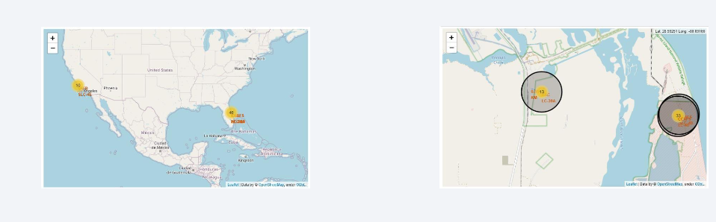
Results
Interactive analytics demo in screenshots

Slide 19
Results
Predictive analysis results
Accuracy for Logistics Regression method: 0.834
Accuracy for Support Vector Machine method: 0.834
Accuracy for Decision tree method: 0.888
Accuracy for K nearsdt neighbors method: 0.834

Slide 20

Section 2

Slide 21
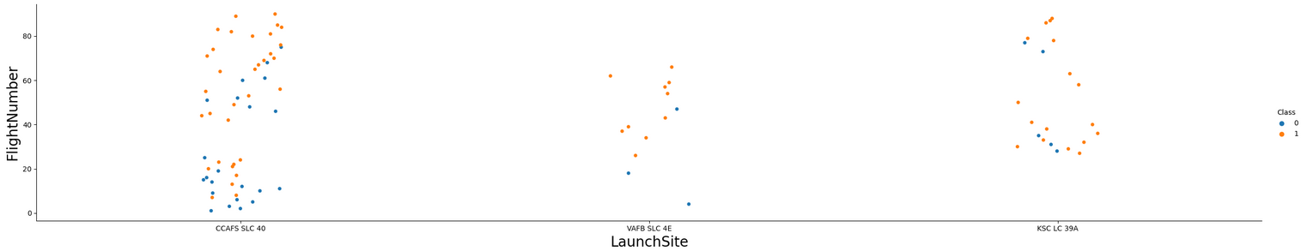
Flight Number vs. Launch Site
Scatter plot of Flight Number vs. Launch Site
the larger the flight amount at a launch site, the greater the success rate at a launch site.

Slide 22
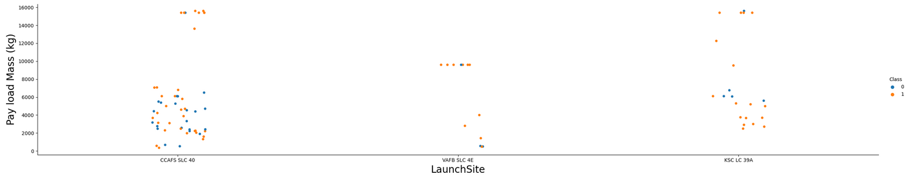
Payload vs. Launch Site
Payload vs. Launch Site
Show the screenshot of the scatter plot with explanations
for the VAFB-SLC launchsite there are no rockets launched for heavypayload mass(greater than 10000).

Slide 23
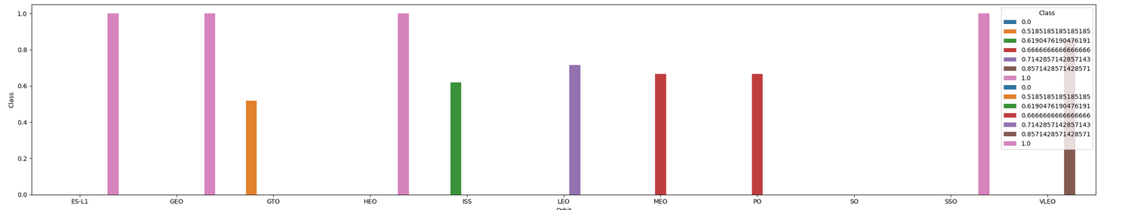
Success Rate vs. Orbit Type
Success rate per orbit type
ES-L1, GEO, HEO, SSO, VLEO had the most success rate.

Slide 24
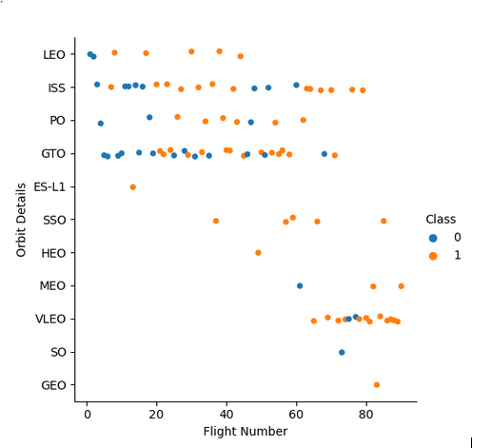
Flight Number vs. Orbit Type
Show a scatter point of Flight number vs. Orbit type
the LEO orbit the Success appears related to the number of flights; on the other hand, there seems to be no relationship between flight number when in GTO orbit.

Slide 25
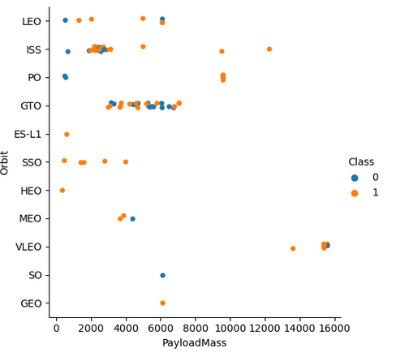
Payload vs. Orbit Type
Show a scatter point of payload vs. orbit type
With heavy payloads the successful landing or positive landing rate are more for Polar,LEO and ISS. However for GTO we cannot distinguish this well as both positive landing rate and negative landing(unsuccessful mission) are both there here.

Slide 26
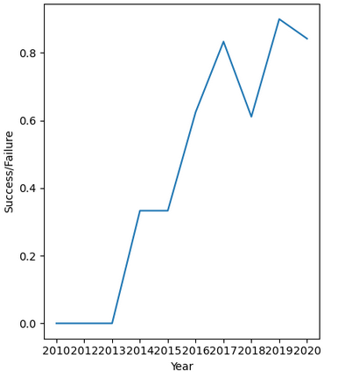
Launch Success Yearly Trend
Show a line chart of yearly average success rate
The success rate since 2013 kept increasing till 2020

Slide 27
All Launch Site Names
Names of the unique launch sites
There a four launch sites as shown above
Launch_Site
CCAFS LC-40
VAFB SLC-4E
KSC LC-39A
CCAFS SLC-40

Slide 28
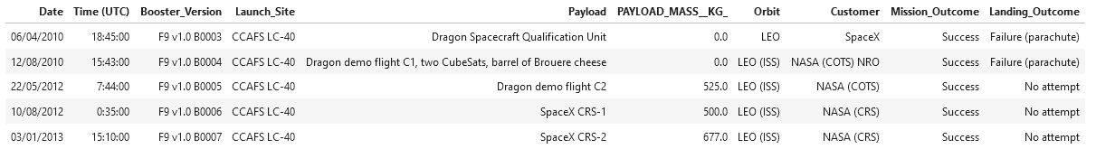
Launch Site Names Begin with 'CCA'
5 records where launch sites begin with `CCA`

Slide 29
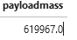
Total Payload Mass
Total payload carried by boosters from NASA
The total payload carried by boosters from NASA is 619967. It is obtained by running the following query :

Slide 30
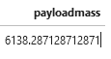
Average Payload Mass by F9 v1.1
The average payload mass carried by booster version F9 v1.1
The average payload mass carried by booster version F9 v1.1 is 6138,3. It is obtained by running the following query :

Slide 31
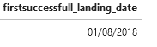
First Successful Ground Landing Date
Dates of the first successful landing outcome on ground pad
The first successful landing outcome on ground pad was on 01/08/2018. The result is obtained by executing the following query :

Slide 32
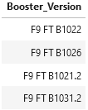
Successful Drone Ship Landing with Payload between 4000 and 6000
The names of boosters which have successfully landed on drone ship and had payload mass greater than 4000 but less than 6000
4 boosters have successfully landed on drone ship and had payload mass greater than 4000 but less than 6000. The query is

Slide 33
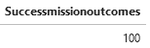
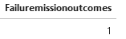
Total Number of Successful and Failure Mission Outcomes
Calculate the total number of successful and failure mission outcomes
We used wildcard like ‘%’ to filter for WHERE MissionOutcome was a success or a failure.

Slide 34
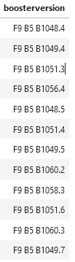
Boosters Carried Maximum Payload
Names of the booster which have carried the maximum payload mass
12 booster have carried the maximum payload mass. The result is obtained by executing the following query:

Slide 35
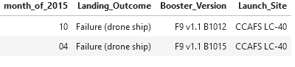
2015 Launch Records
Failed landing_outcomes in drone ship, their booster versions, and launch site names for in year 2015
There are 2 drones ship which fail in 2015. The query is

Slide 36
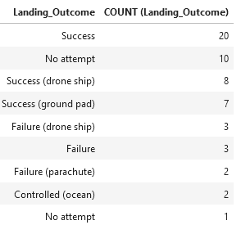
Rank Landing Outcomes Between 2010-06-04 and 2017-03-20
Count of landing outcomes between the date 2010-06-04 and 2017-03-20, in descending order
We selected Landing outcomes and the COUNT of landing outcomes from the data and used the WHERE clause to filter for landing outcomes BETWEEN 2010-06-04 to 2010-03-20. then, we applied the GROUP BY clause to group the landing outcomes and the ORDER BY clause to order the grouped landing outcome in descending order.

Slide 37

Section 3

Slide 38

<Folium Map Screenshot 1>

Slide 39

<Folium Map Screenshot 2>
Replace <Folium map screenshot 2> title with an appropriate title
Explore the folium map and make a proper screenshot to show the color-labeled launch outcomes on the map
Explain the important elements and findings on the screenshot

Slide 40

<Folium Map Screenshot 3>
Replace <Folium map screenshot 3> title with an appropriate title
Explore the generated folium map and show the screenshot of a selected launch site to its proximities such as railway, highway, coastline, with distance calculated and displayed
Explain the important elements and findings on the screenshot

Slide 41

Section 4

Slide 42

<Dashboard Screenshot 1>
Replace <Dashboard screenshot 1> title with an appropriate title
Show the screenshot of launch success count for all sites, in a piechart
Explain the important elements and findings on the screenshot
KSC LC-39A had the most successful launches

Slide 43
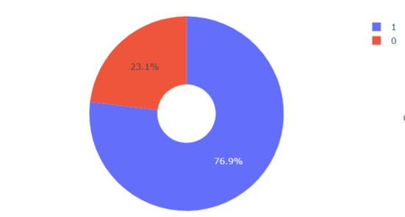
<Dashboard Screenshot 2>

Slide 44
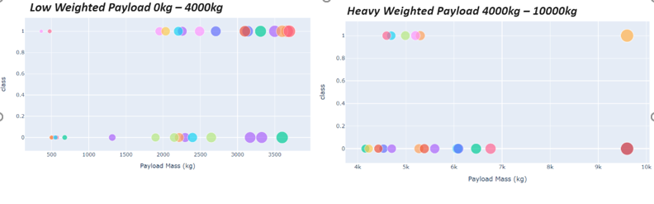
<Dashboard Screenshot 3>

Slide 45

Section 5

Slide 46
Classification Accuracy
The best model is decision tree

Slide 47
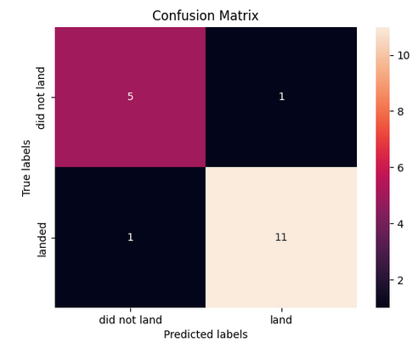
Confusion Matrix

Slide 48
Conclusions
The larger the flight amount at a launch site, the greater the success rate at a launch site.
Launch success rate started to increase in 2013 till 2020.
Orbits ES-L1, GEO, HEO, SSO, VLEO had the most success rate.
KSC LC-39A had the most successful launches of any sites.
The Decision tree classifier is the best machine learning algorithm for this task.

Slide 49
Appendix
Include any relevant assets like Python code snippets, SQL queries, charts, Notebook outputs, or data sets that you may have created during this project

Slide 50


